Slide 1
A Hybrid Genetic Algorithm for the Periodic
Vehicle Routing Problem with Time Windows
Michel Toulouse ^{1,2} Teodor Gabriel Crainic² Phuong Nguyen²
¹Oklahoma State University
² Interuniversity Research Centre on Enterprise Networks, Logistics and Transportation (CIRRELT)
Stillwater, November 2010

Slide 2
Presentation Outline
1
Introduction
2
Periodic Vehicle Routing Problem with Time Windows
3
Genetic Algorithms
4
A Hybrid Genetic Algorithm for PVRPTW
5
5
Conclusion

Slide 3
Introduction

Slide 4
Introduction

Slide 5
Vehicle Routing Problem (VRP)

Slide 6
VRP with Time Windows (VRPTW)

Slide 7
Description of PVRPTW
The Periodic Vehicle Routing Problem with Time Windows (PVRPTW) is defined as having:
A planning horizon of t days,
n customers having a demand q_{i} > 0, a service duration d_{i} >0, a time window [e_{i}, l_{i} ], a service frequency f_{i} and a set R_{i} of allowable patterns of visit days,
a single depot with time window [e₀, l₀], at which is based a fleet of m vehicles with limited on capacity and duration,
a cost (or travel time) c_{ij} > 0 between the locations.

Slide 8
Description of PVRPTW
The PVRPTW aims to select a single visit day pattern per customer and design at most m vehicle routes on each day of the planning horizon such that:
each route starts and ends at the depot in the interval [e₀, l₀],
each customer i belongs to exactly f_{i} routes over the horizon and is serviced in the interval [e_{i}, l_{i} ],
the total capacity and duration of route k do not exceed Q_{k} and D_{k} , respectively,
the total cost (or travel time) of all vehicles is minimized.

Slide 9
PVRPTW’s mathematical formulation

Slide 10
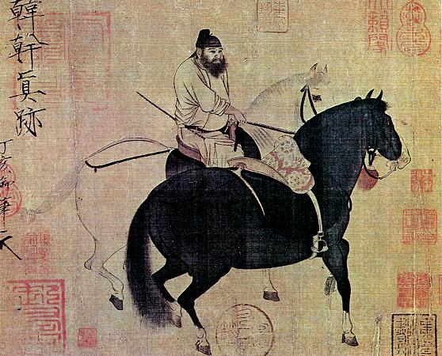
Genetic Algorithms: Engineering view
Two horses and a groom (Han Gan [Tang Dynasty])

Slide 11
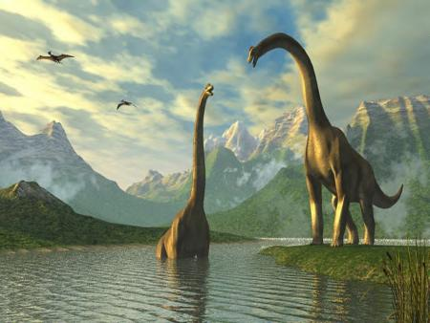
Genetic algorithms: Evolutionary view
Species constantly have to adapt to changes in their environment.
Fittest individuals of a specie live long enough to breed (natural selection).
They pass their genetic adaptive features to their offspring.
Through several generations, the specie get the upper hand on environment changes.

Slide 12
GA as an optimization method
A stochastic search method.
The environment is the cost function.
A specie is a set of solutions
Individuals are solutions, the cost of a solution measure it fitness. Furthermore, solutions are encoded under a suitable representation.
Individuals (solutions) are selected to breed based on a random procedure biased by the fitness of the solutions.
Breeding consists to brake solutions into components and to reassemble components to create offspring.

Slide 13
GA as optimization method
Generation of an initial population
“Parent” population
Reproduction of
a generation
Select two parents
Generation of a new “parent” population from “children” population
Reproduction of parents
Mutation of children
“Children” population
NO
Stop evolution ?
YES
Get solution from “children” population

Slide 14
Pseudo code for generational GAs

Slide 15
Overview of our GA for PVRPTW
START
Initial population
1st generation
N^{th} generation
Fitter individuals
Random
individuals
Immigration
Unfit individuals
Fitter individuals
Mating pool
Offspring
New individuals
Roulette wheel
Crossover & mutation
Repair
New
population
“Children” population
NO
N > genMAX ?
YES
STOP

Slide 16
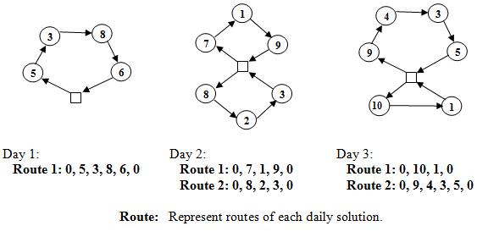
Representation of individuals

Slide 17
Individual fitness

Slide 18
Algorithmic elements
START
Initial population
1st generation
N^{th} generation
Fitter individuals
Random
individuals
Immigration
Unfit individuals
Fitter individuals
Mating pool
Offspring
New individuals
Roulette wheel
Crossover & mutation
Repair
New
population
“Children” population
NO
N > genMAX ?
YES
STOP

Slide 19
The initial population
Each customer is assigned a feasible pattern of visit days randomly.
Solve VRPTW by applying:
Time-Oriented, Sweep Heuristic by Solomon.
Parallel route building by Potvin and Rousseau.
Our route construction method.

Slide 20
Algorithmic elements
START
Initial population
1st generation
N^{th} generation
Fitter individuals
Random
individuals
Immigration
Unfit individuals
Fitter individuals
Mating pool
Offspring
New individuals
Roulette wheel
Crossover & mutation
Repair
New
population
“Children” population
NO
N > genMAX ?
YES
STOP

Slide 21
Roulette Wheel selection operator

Slide 22
Algorithmic elements
START
Initial population
1st generation
N^{th} generation
Fitter individuals
Random
individuals
Immigration
Unfit individuals
Fitter individuals
Mating pool
Offspring
New individuals
Roulette wheel
Crossover & mutation
Repair
New
population
“Children” population
NO
N > genMAX ?
YES
STOP

Slide 23
The first crossover operator

Slide 24
The first crossover operator

Slide 25
The first crossover operator

Slide 26
The first crossover operator

Slide 27
The first crossover operator

Slide 28
The first crossover operator

Slide 29
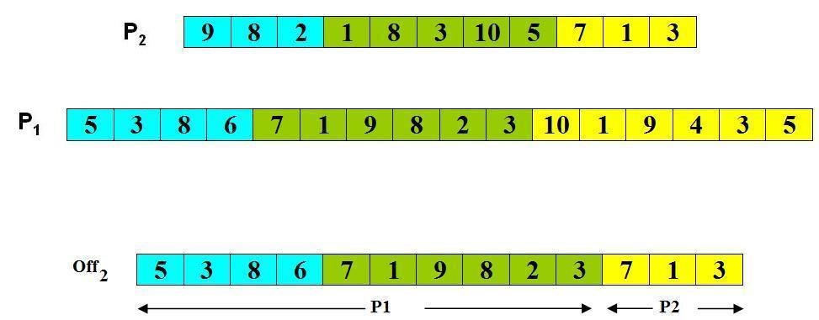
The second crossover operator
For each day t, one parent among {P₁, P₂} is selected randomly, from which all routes in day t are copied into the offspring Off₂.
Remove/insert customers from/into days such that the pattern of visit days of all customers are satisfied.

Slide 30
Algorithmic elements
START
Initial population
1st generation
N^{th} generation
Fitter individuals
Random
individuals
Immigration
Unfit individuals
Fitter individuals
Mating pool
Offspring
New individuals
Roulette wheel
Crossover & mutation
Repair
New
population
“Children” population
NO
N > genMAX ?
YES
STOP

Slide 31
At issues
GA not well adapted to constrained optimization, crossover create infeasible solutions.
PVRPTW is a heavily constrained optimization problem.
Usually repair strategies aim at regaining feasibility, but for PVRPTW this often leads to very poor solutions.
Not only solutions are poor, but also their genetic make-up (building blocks hypothesis).
Need to repair not only feasibility but also the building block features of the population.
Make use of metaheuristics.

Slide 32
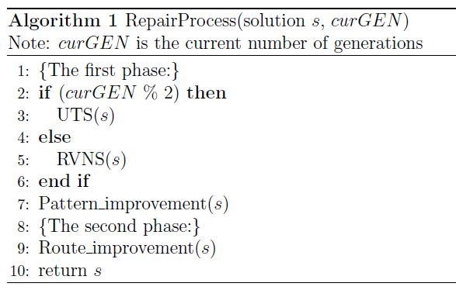
Repair strategies
Phase 1: Simultaneously tackle routing and pattern improvements
Unified Tabu of Cordeau et al.
Random VNS of Pirkwieser and Raidl: order of neighborhood structures are chosen randomly
Pattern improvement: explore all feasible patterns of all customers where each customer is reassigned to new pattern, one by one
Phase 2: Routing improvements
locally re-optimize the routes in which hybridized neighborhood structures with a set different route improvement techniques are used

Slide 33
Algorithmic elements
START
Initial population
1st generation
N^{th} generation
Fitter individuals
Random
individuals
Immigration
Unfit individuals
Fitter individuals
Mating pool
Offspring
New individuals
Roulette wheel
Crossover & mutation
Repair
New
population
“Children” population
NO
N > genMAX ?
YES
STOP

Slide 34
Replacement
nPop parents are selected from the current population using Roulette wheel to build the mating pool and nPop offspring are then created.
The next generation is composed of the nKeep best individuals among the pool of chromosomes in the current population (nKeep < nPop) and nPop new offspring.

Slide 35
Previous works
20 instances generated by Cordeau et al.
Unified Tabu Search of Cordeau et al. (2001)
(1) move a customer, (2) change pattern of a customer,
accept infeasible solutions.
Variable Neighborhood Search of Pirkwieser and Raidl (2008)
change pattern of a customer, (2) move a segment, (3) exchange segments,
accept worse solutions.
45 instances generated by Pirkwieser and Raidl
Hybrid scheme between VNS and ILP-based column generation approach (2009)
Multiple cooperating VNS (2010)
Hybrid scheme between multiple-VNS and ILP-based column generation approach (2010)

Slide 36
Instances
Benchmark | #instances | #customers | #vehicles | Planning period
Cordeau et al. | 20 | [48, 288] | [3, 20] | 4 or 6 days
S.Pirkwieser & Raidl | 45 | 100 | [7, 14] | 4, 6 or 8 days

Slide 37
Experiment parameters
Parameters | Setting | Final values
 |  | Small instance | Large instance
Population size (nPop) | [50, 400] | 100 | 350
Number of elite (nKeep) | [25, 300] | 60 | 200
Number of iterations applying UTB | [20, 120] | 60 | 100
Number of iterations applying VNS | [100, 800] | 100 | 200

Slide 38
Numerical Results
Compare with currently best published results:
For 20 instances generated by Cordeau et al.: produces 19 new best known solutions, with improved quality of 0.75% on average in term of best solutions cost.
For 45 instances generated by S.Pirkwieser and Raidl: produces solutions with improve quality of 0.88% on average in term of average solutions cost.

Slide 39
Numerical Results
Instances |  |  |  |  |  | UTB | VNS | HGA | %GAP to BKS
No | n | T | m | D | Q
1a | 48 | 4 | 3 | 500 | 200 | 3007.84 | 2989.58 | 2989.58 | 0
2a | 96 | 4 | 6 | 480 | 195 | 5328.33 | 5127.98 | 5107.51 | -0.40
3a | 144 | 4 | 9 | 460 | 190 | 7397.10 | 7260.37 | 7158.77 | -1.40
4a | 192 | 4 | 12 | 440 | 185 | 8376.95 | 8089.15 | 7981.85 | -1.33
5a | 240 | 4 | 15 | 420 | 180 | 8967.90 | 8723.63 | 8666.59 | -0.65
6a | 288 | 4 | 18 | 400 | 175 | 11686.91 | 11063.00 | 10999.90 | -0.57
7a | 72 | 6 | 5 | 500 | 200 | 6991.54 | 6917.71 | 6892.71 | -0.36
8a | 144 | 6 | 10 | 475 | 190 | 10045.05 | 9854.36 | 9751.66 | -1.04
9a | 216 | 6 | 15 | 450 | 180 | 14294.97 | 13891.03 | 13707.30 | -1.32
10a | 288 | 6 | 20 | 425 | 170 | 18609.72 | 18023.62 | 17754.20 | -1.49
1b | 48 | 4 | 3 | 500 | 200 | 2318.37 | 2289.17 | 2284.83 | -0.19
2b | 96 | 4 | 6 | 480 | 195 | 4276.13 | 4149.96 | 4141.15 | -0.21
3b | 144 | 4 | 9 | 460 | 190 | 5702.07 | 5608.67 | 5567.15 | -0.74
4b | 192 | 4 | 12 | 440 | 185 | 6789.73 | 6534.12 | 6471.74 | -0.95
5b | 240 | 4 | 15 | 420 | 180 | 7102.36 | 6995.87 | 6963.11 | -0.47
6b | 288 | 4 | 18 | 400 | 175 | 9180.15 | 8895.31 | 8855.97 | -0.44
7b | 72 | 6 | 5 | 500 | 200 | 5606.08 | 5517.71 | 5509.08 | -0.16
8b | 144 | 6 | 10 | 475 | 190 | 7987.64 | 7712.40 | 7677.68 | -0.45
9b | 216 | 6 | 15 | 450 | 180 | 11089.91 | 10944.59 | 10874.80 | -0.64
10b | 288 | 6 | 20 | 425 | 170 | 14207.64 | 14065.16 | 13851.40 | -1.52

Slide 40
Conclusion
This algorithm outperforms the best existing methods for solving PVRPTW.
It is part of a larger project to develop a cooperative system for VRP:
A set S = {1, 2,…,n} of n different search agents with dynamics x_{i}(t + 1) = h_{i} (x_{i} (t - 1)), i ∈ S
Agents are part of a network which can be represented by an oriented graph G = (V, E), V = {1, 2,…,n} and E ⊆ V x V
are the neighbors of search agent i
Cooperation protocol:

