Slide 1
OS Interaction with Cache Memories
Dr. Sohum Sohoni
School of Electrical and Computer Engineering
Oklahoma State University

Slide 2
Outline
Technically ‘light’ talk- broad audience
Background terminology and one example of current work
Wild predictions about the future
Many thanks to the National Science Foundation CNS #0720741
Any views presented here are my own, and not reflective of the NSF’s views and policies

Slide 3
Some Terminology
CPU Caches
Miss rates
Locality
Prefetching
Context Switches
‘state’
Working set or memory footprint
Process queue

Slide 4
Goal of Memory Hierarchy
Low latency, high bandwidth, high capacity, low cost
300 cycles
2+7 = 9 cycles
Main Memory
(System DRAM)
3GHz
2 cycles
L1 Cache
L2 Cache
CPU
16 KB
512 KB
Extremely fast bus
Slower bus
Much slower bus
512 MB

Slide 5
What Happens in a Context Switch
Current process ‘state’ is saved
Scheduler is invoked
Next process is ‘brought in’
TLB’s are flushed
L1 cache may be flushed
New process executes for its time slice
Interrupt, state saved, scheduler …
Effective locality gets wiped out

Slide 6
Effect of MultiProgramming
Memory pressure
CPU
I/O
CPU
I/O
CPU
CPU
I/O
CPU
Memory pressure
10ms
20ms
30ms
40ms
50ms
60ms
CPU
CPU
CPU
CPU
CPU
CPU
CPU
CPU
CPU
I/O
I/O
I/O
10ms
20ms
30ms
40ms
50ms
60ms

Slide 7
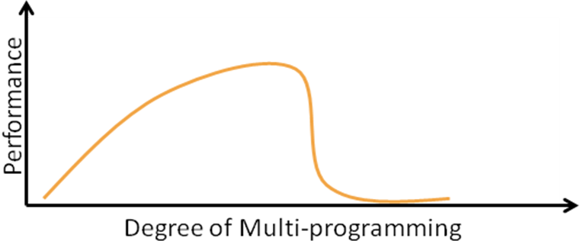
Problem with MultiProgramming
Increasing multi-programming increases cache miss rates
Loss of locality of reference
Diminishing returns from multi-programming
Eventual thrashing
k

Slide 8
Out of Context Prefetching
Reduce the negative effect of multi-programming on CPU cache performance
Predict future context switches
Prefetch the working set of the next process
Context Switch!
Prefetch
Memory Pressure
Time

Slide 9
OOC Prefetching Picture
Main memory
L2
OOC Prefetch
L1
CPU

Slide 10
Context Switch Prediction

Slide 11
Miss Rate Improvement

Slide 12
Thank you! Q and A

